Slide 1
بسم الله الرحمن الرحيم

Slide 2

Newtonian Mechanics Newton’s First Law
In other words, if the body is at rest, it stays at rest. If it is moving, it continues to move with the same velocity (same magnitude and same direction).

Slide 3


Inertial: The resistance of the body for the change in it’s state
Newton’s Second Law

Slide 4




A gravitational force
on a body is a certain type of pull that is directed toward a second body.
$F_{g}$
we usually mean a force that pulls on it directly toward the center of Earth that is, directly down toward the ground.
Free Fall: Suppose a body of mass m is in free fall with the free-fall acceleration of magnitude g. Then, if we neglect the effects of the air, the only force acting on the body is the gravitational force
$F_{g}$

Slide 5

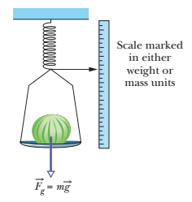


Slide 6

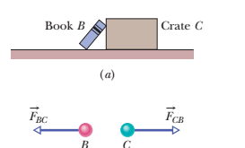
Caution: A body’s weight is not its mass Weight is the magnitude of a force and is related to mass If you move a body to a point where the value of g is different, the body’s mass (an intrinsic property) is not different but the weight is.
Newton’s Third Law

Slide 7

UNIFORM CIRCULAR MOTION
when a body moves in a circle (or a circular arc) at constant speed v, it is said to be in uniform circular motion and the body has a centripetal acceleration (directed toward the center of the circle) of constant magnitude given by:
where R is the radius of the circle.

Slide 8


From Newton’s second law and the last equation of acceleration we can write the magnitude F of a centripetal force (or a net centripetal force) as
Because the speed v here is constant, the magnitudes of the acceleration and the force are also constant.

Slide 9
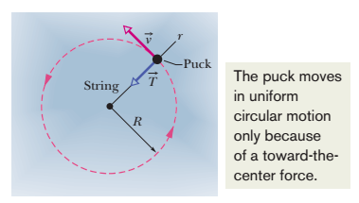
However, the directions of the centripetal acceleration and force are not constant; they vary continuously so as to always point toward the center of the circle. For this reason, the force and acceleration vectors are sometimes drawn along a radial axis r that moves with the body and always extends from the center of the circle to the body. The positive direction of the axis is radially out ward, but the acceleration and force vectors point radially inward.

Slide 10
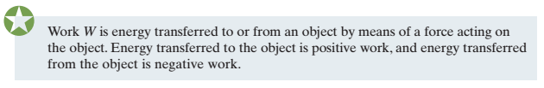
Kinetic Energy
Kinetic energy K is energy associated with the state of motion of an object. The faster the object moves, the greater is its kinetic energy. When the object is stationary, its kinetic energy is zero and on only one way in which energy can be transferred (work).
WORK AND KINETIC ENERGY

Slide 11



“Work,” then, is transferred energy; “doing work” is the act of transferring the energy. Work has the same units as energy and is a scalar quantity
Finding an Expression for Work

Slide 12
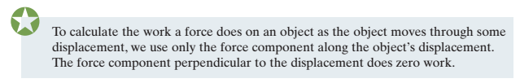

Slide 13
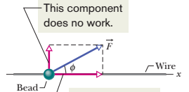

Work Done by the Gravitational Force

Slide 14
Thank you

